Slide 1
Module 2
Introduction to AI Agents & Stock Market Analysis
Notes:
Exploring how AI agents revolutionize stock analysis

Slide 2
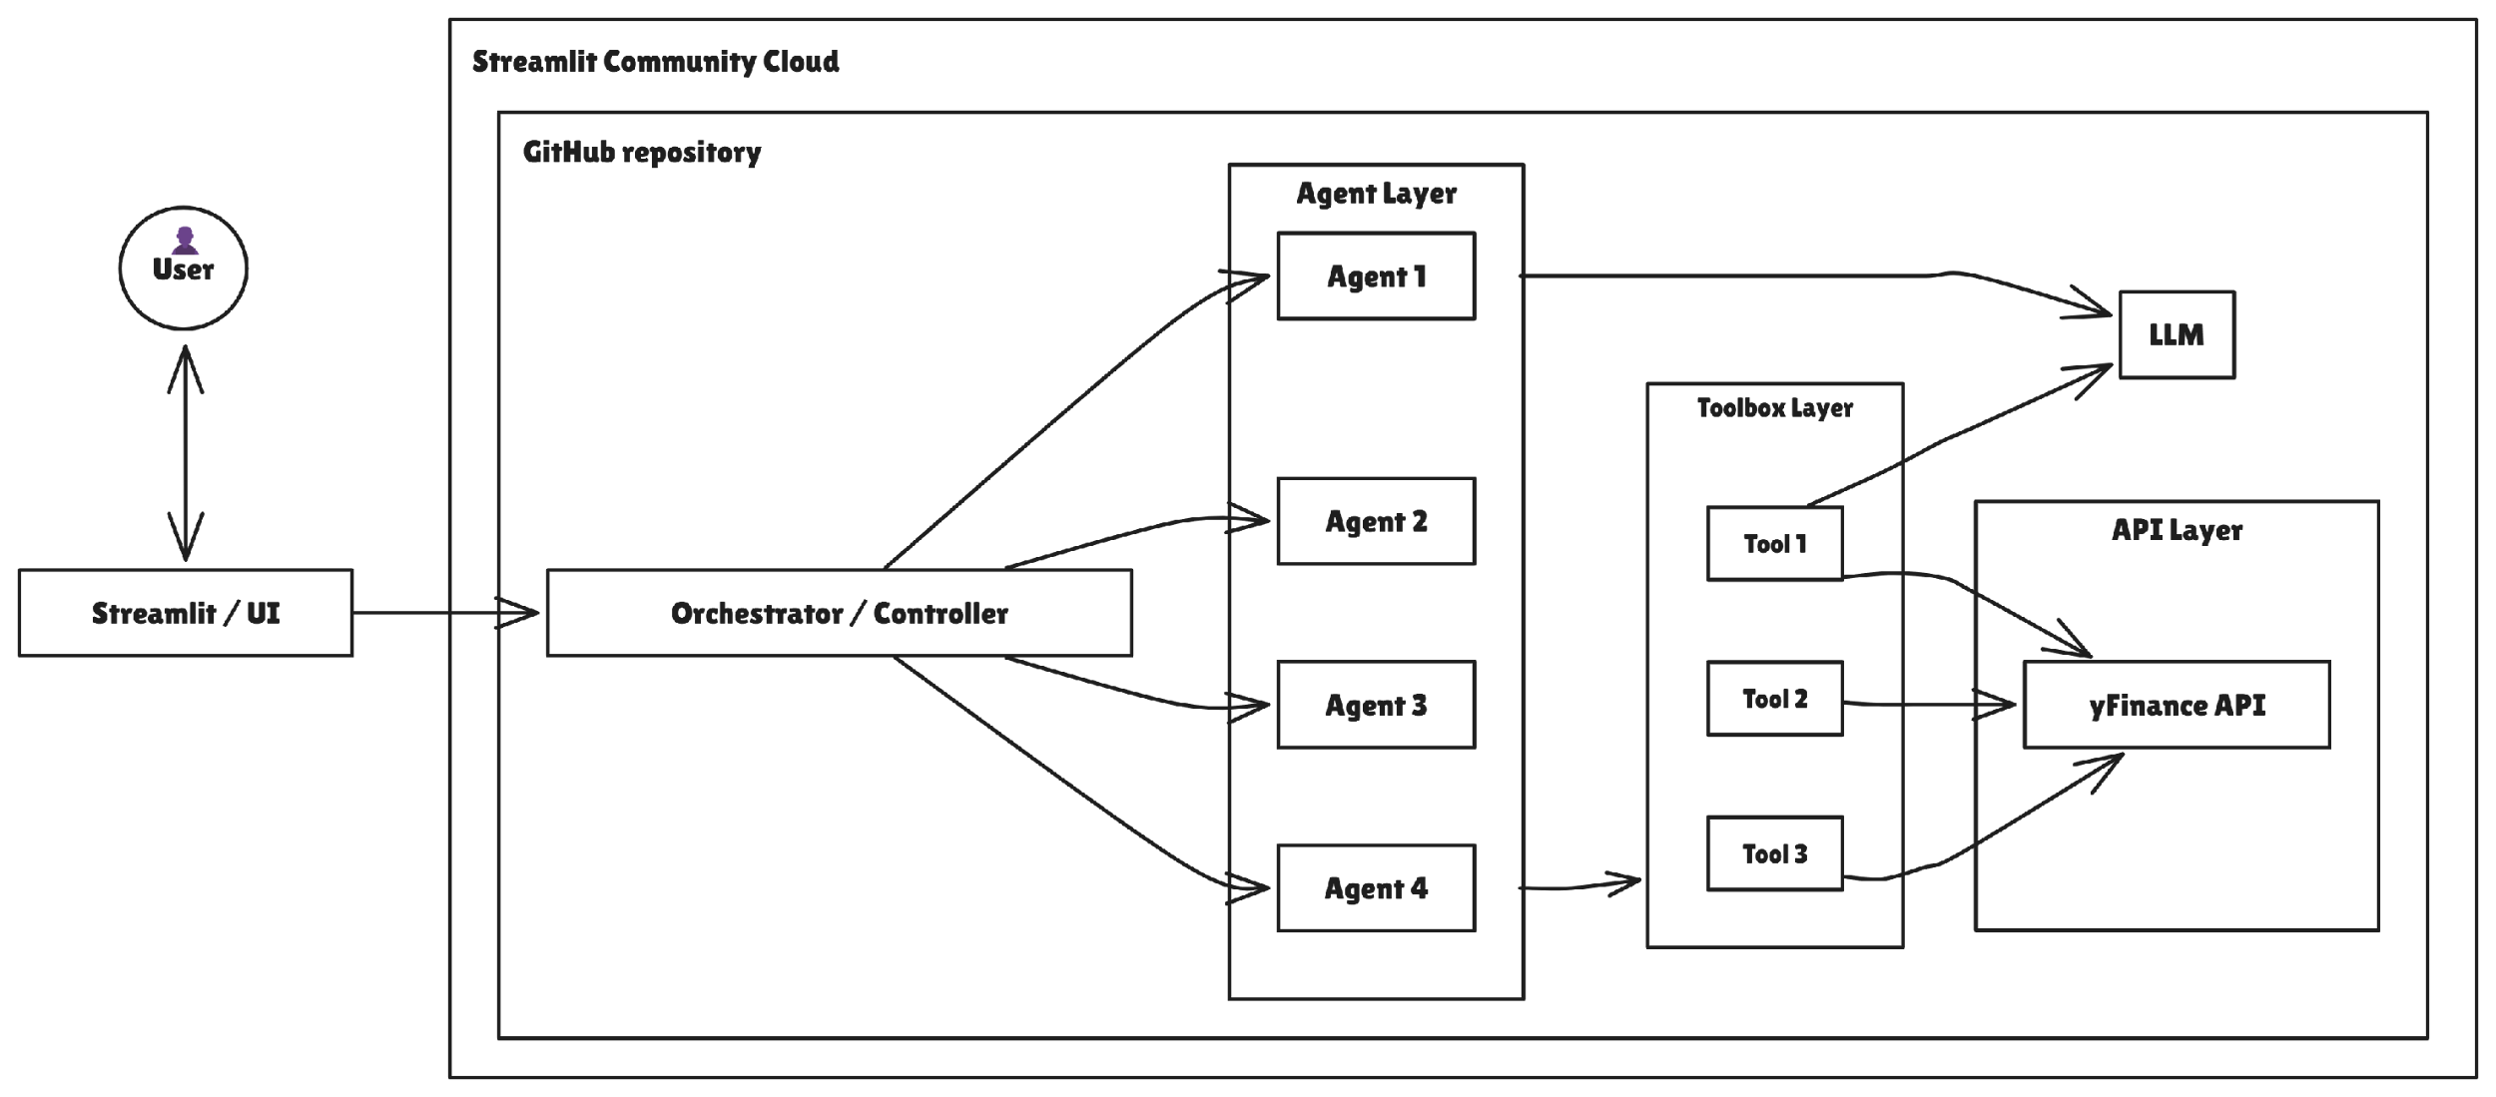

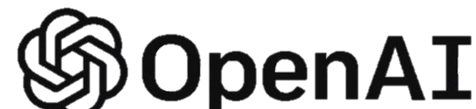


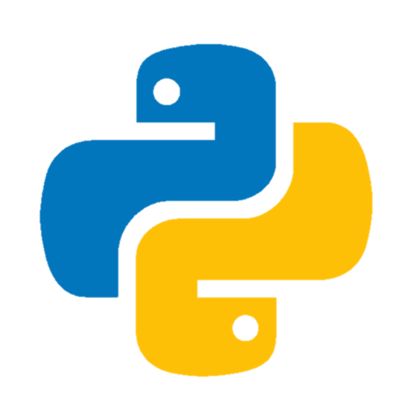
End-to-End Architecture Overview

Slide 3
System Components & Stack
Component | Primary Tech | Alternates
Frontend/UI | Streamlit + Python 🐍⚡ | React.js + Flask, Gradio, Dash
Deployment | Streamlit Community Cloud ☁️ | Azure App Service, AWS EC2, Vercel
Codebase | GitHub 📁 | GitLab, Bitbucket
Orchestrator | AutoGen AG 🧠 | LangChain, CrewAI, Haystack Agents
Agent Layer | Modular Python Agents 🤖 | LangGraph, HuggingGPT, Custom FSMs
Toolbox Layer | Python Modules + yFinance Integration 🛠 | Alpha Vantage, Finnhub, Twelve Data
Data Source | yFinance API 💹 | Polygon.io, IEX Cloud, Quandl
LLM | OpenAI GPT 🧠 | Anthropic Claude, Mistral, Cohere, LLama2

